Slide 1



Eduvision_DV
Higher Education Intelligence System

Slide 2







Technology Stack: Higher Education Analytics Stack
Node.js
Python
Pandas
Numpy
Tableau
The Foundation of data analytics,used for data collection,data cleaning and analytical workflows .
Used for data manipulation and analysis.Pandas provides powerful DataFrames and tools for cleaning and preparing datasets.
Supports Numerical computing and efficient array processing,enabling mathematical operations used in data preparation and analysis
Transforms complex datasets into interactive dashboards,making higher education insights easier to explore and understand

Slide 3

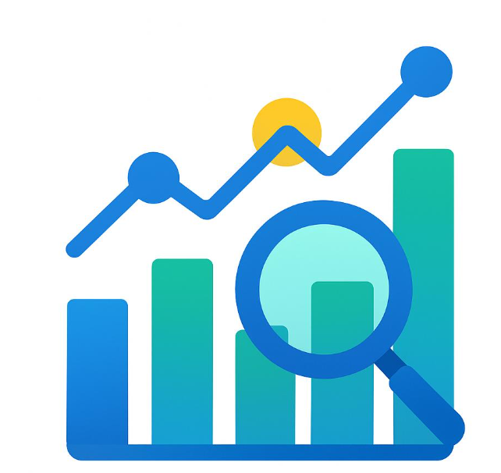
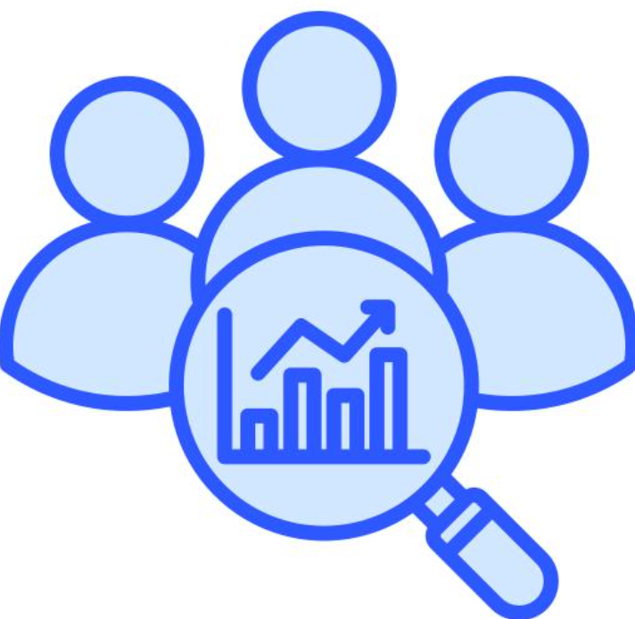
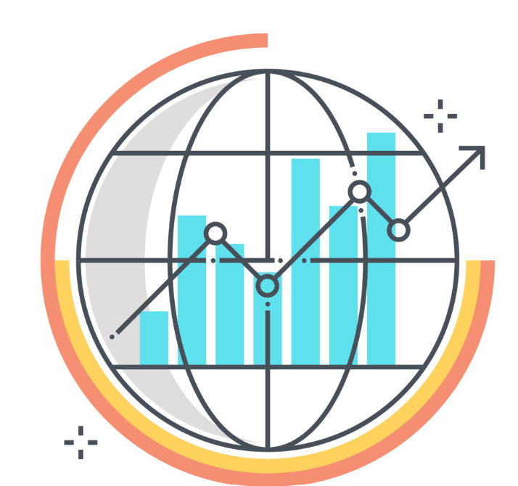
Core Features of EduVision_DV
Four interactive dashboards for exploring higher education performance,research,students,and countries
University Overview
Research Analytics
Country Comparison
Student Analytics
Summarizes university performance through ranking, academic reputation, research, and student-related KPIs.
Explores research impact and productivity using KPI comparisons and research trends.
Supports country-level comparison of higher education indicators, with region and year filters..
Presents faculty–student ratio, international student percentage, and related academic indicators.
Interactive filters • KPI summaries • Visual comparisons • Dashboard navigation

Slide 4




Challenges in Higher Education Analytics
1
2
Scattered Data Sources
Difficult Comparisons
University rankings and education statistics come from different datasets and sources.
Comparing universities, research performance, and countries requires clear and consistent indicators.
3
4
Complex Performance Metrics
Limited Interactive Exploration
Ranking, research, and student indicators can be difficult to interpret in raw tables.
Users need convenient ways to filter by university, country, region, and year to explore specific results.
EduVision_DV addresses these challenges through cleaned datasets, KPI summaries, interactive filters, and four Tableau dashboards.

Slide 5
System Architecture Overview
The system architecture of EduVision_DV follows a data analytics workflow designed to transform higher education datasets into meaningful visual insights:
  Data Sources: QS World University Rankings 2025, Times Higher Education World University Rankings 2024, World University Rankings 2023, and World Bank Education Statistics.
  Data Preparation: Python, Pandas, and NumPy support data inspection, cleaning, normalization, and validation.
  Visualization Layer: Tableau connects the prepared dataset to create four interactive dashboards: University Overview, Research Analytics, Student Analytics, and Country Comparison.
  Interactive Analysis: KPIs, charts, filters, and dashboard navigation help users explore university performance, research indicators, student metrics, and country-level comparisons.

Slide 6
Challenges and Solutions in EduVision_DV
1
2
Scattered Data Sources
Inconsistent Data
Challenge: University rankings and education statistics come from different datasets and formats.
Solution: Python and Pandas support data collection, cleaning, and consolidation into analysis-ready datasets.
Challenge: Missing values, different ranking formats, and inconsistent fields make comparisons difficult.
Solution: Data inspection, cleaning, normalization, and validation improve consistency before visualization.
3
4
Complex Performance Metrics
Limited Data Explorations
Challenge: Ranking, research, and student indicators can be difficult to interpret in raw tables.
Solution: Tableau dashboards present key performance indicators (KPIs) and charts for easier analysis.
Challenge: Users need to examine specific universities, countries, regions, and years.
Solution: Interactive filters and navigation across four dashboards support focused comparisons.

Slide 7
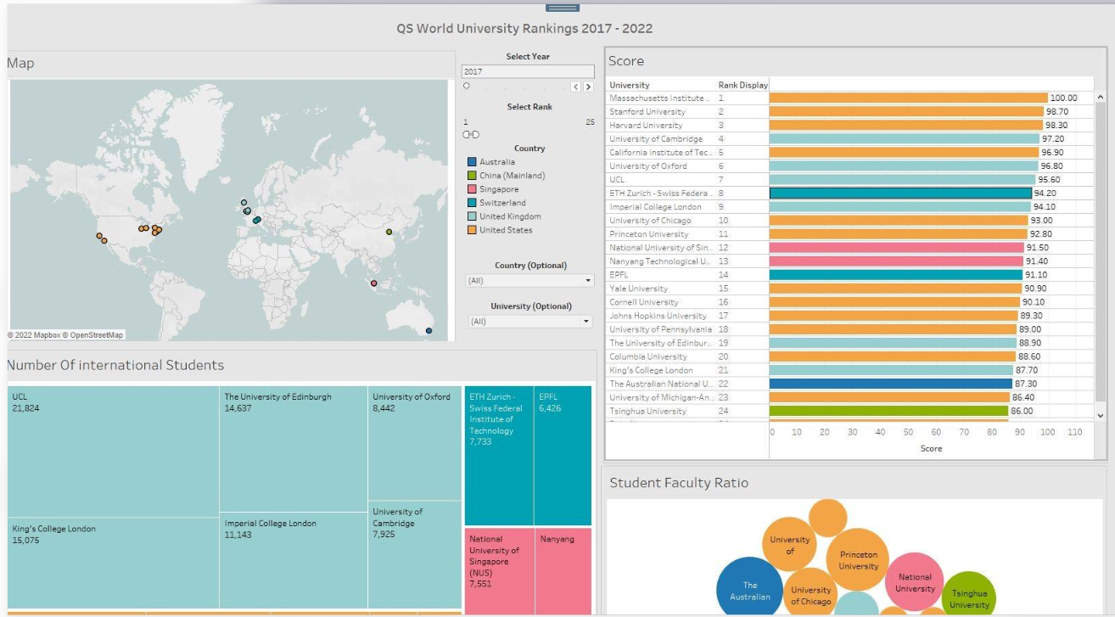
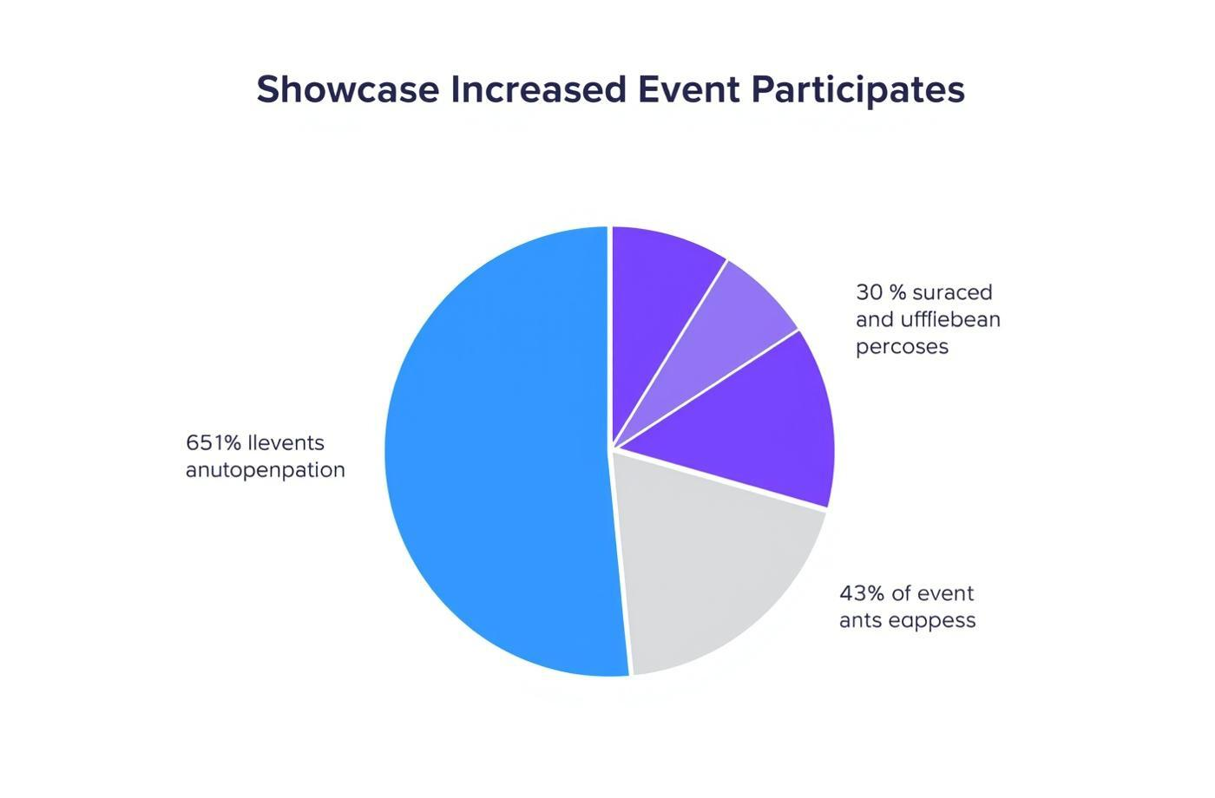
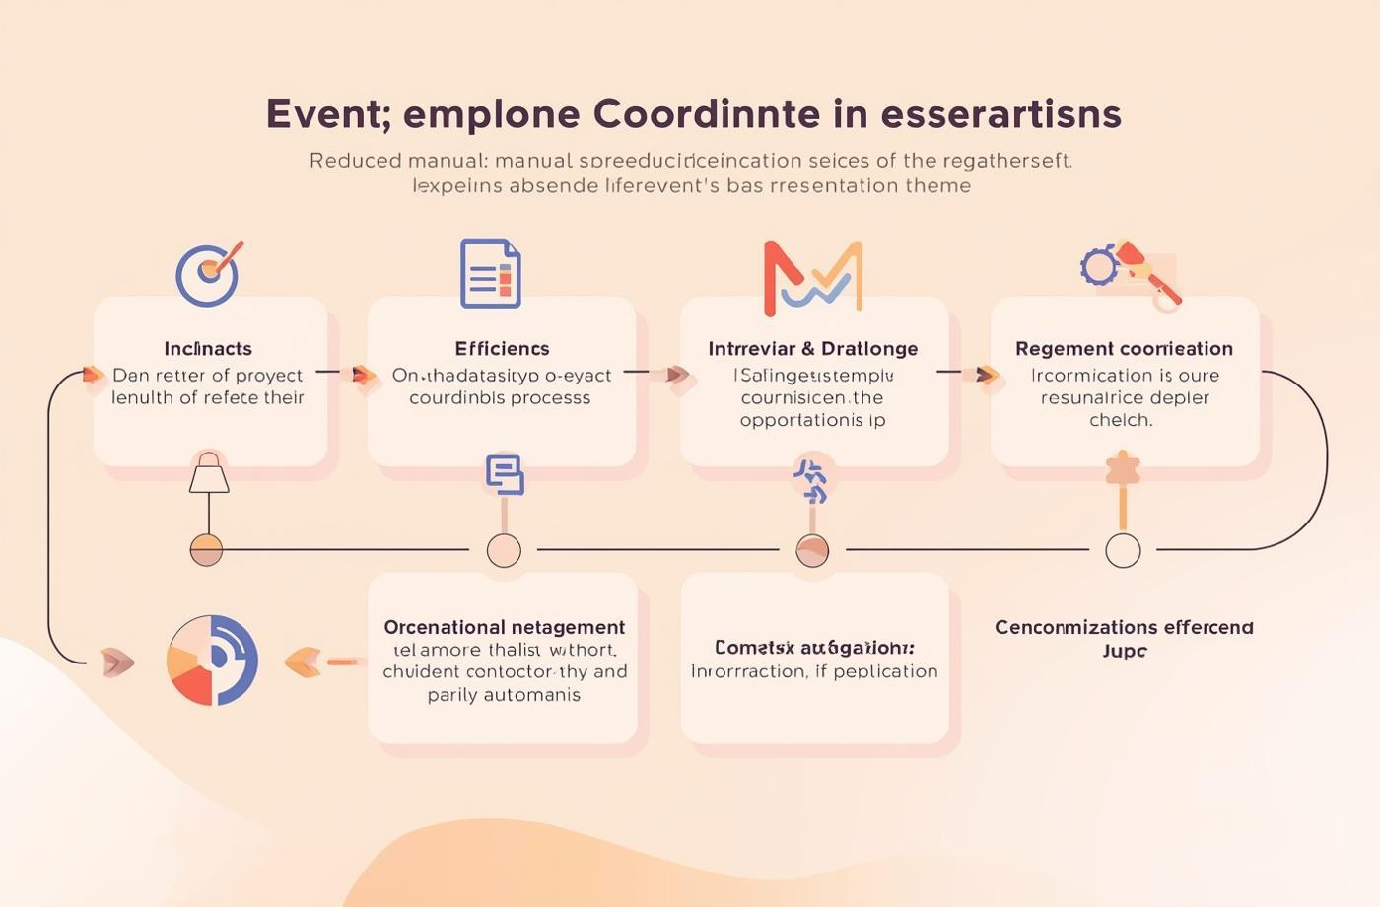
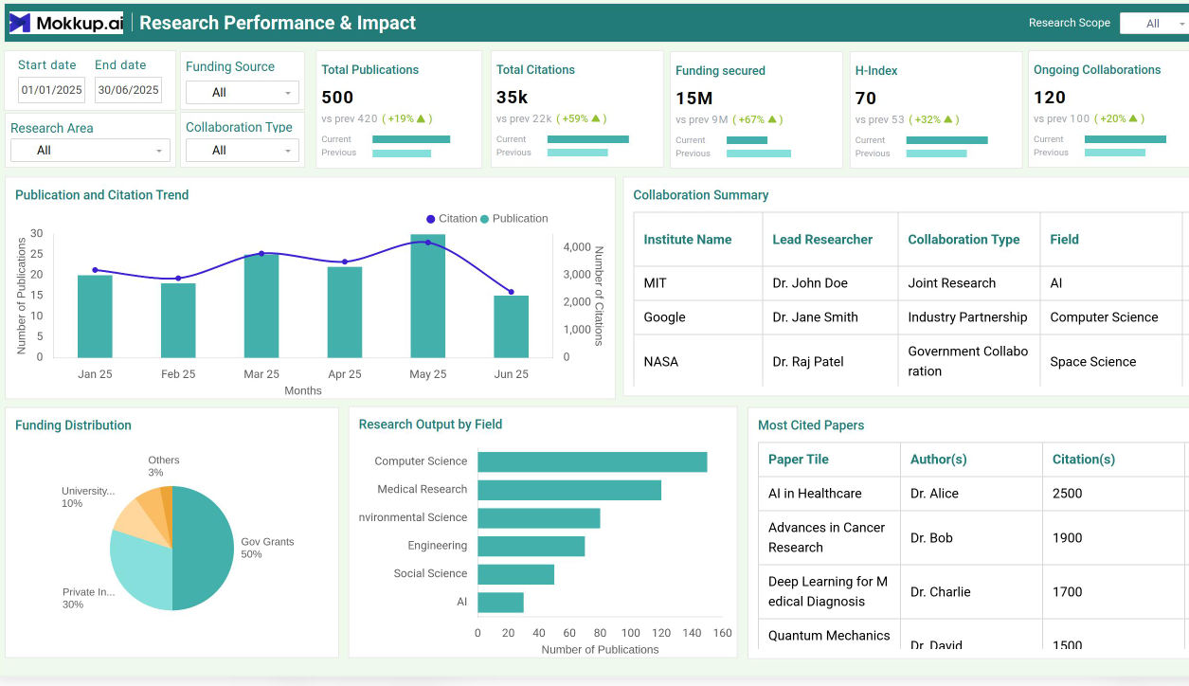
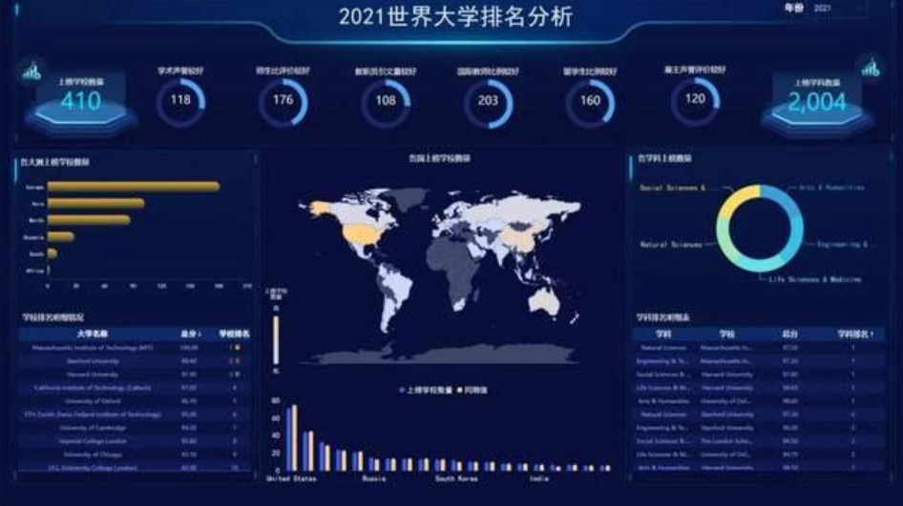

Measurable Outcomes and Positive Impact
Improved Data Visibility
Simplified Performance Analysis
Better Comparative Insights
University ranking, academic reputation, and performance KPIs are presented in a clear visual format.
Research and student indicators can be explored through KPI summaries, charts, and interactive filters.
Country, region, and year filters help users compare higher education indicators across different contexts.

Slide 8
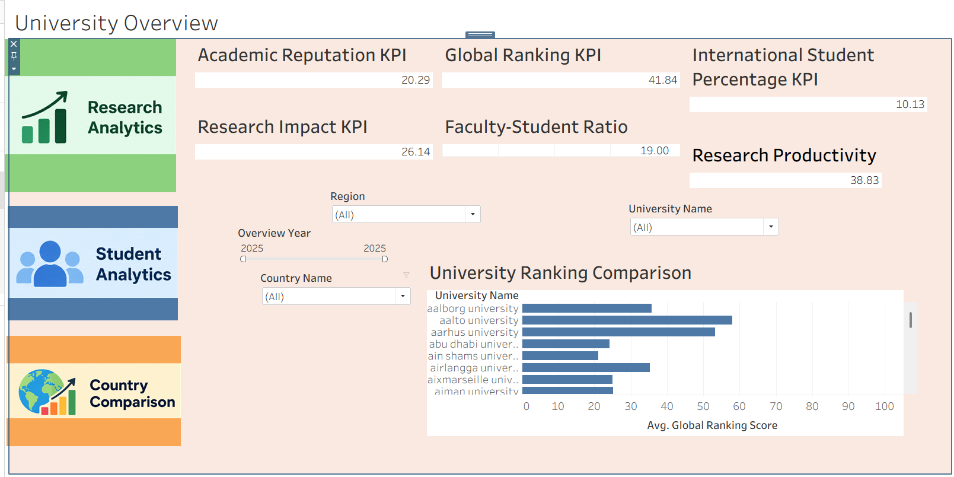
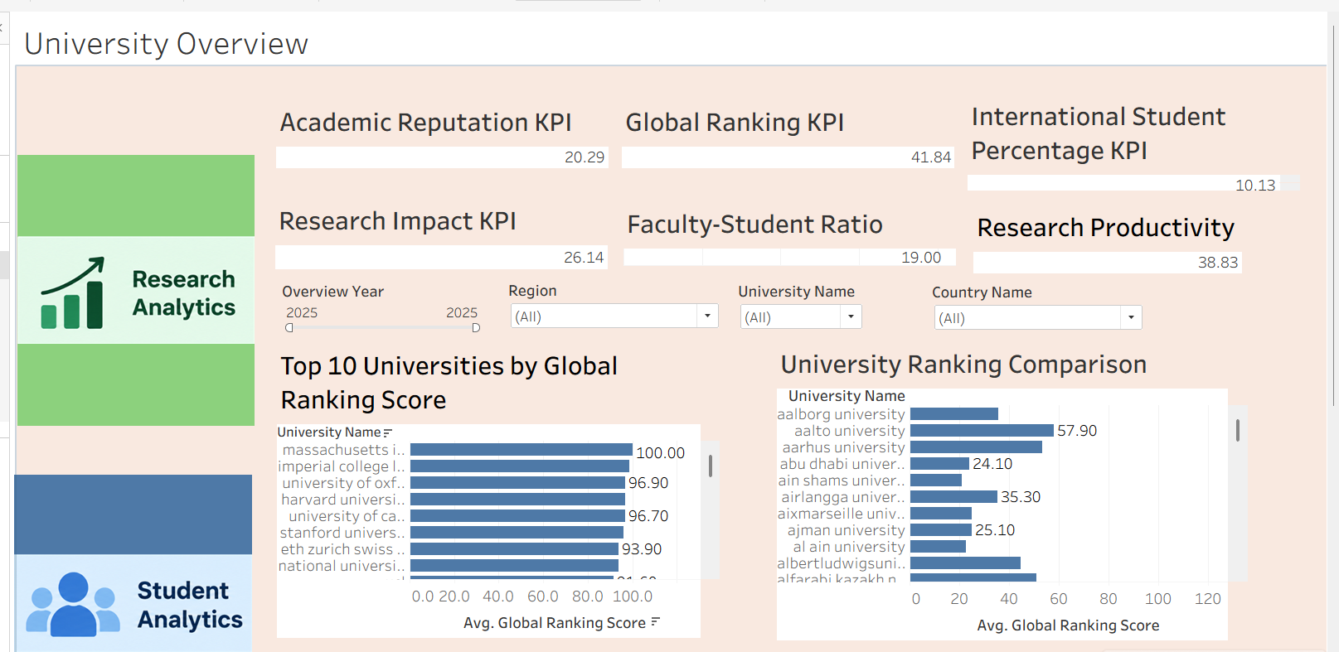
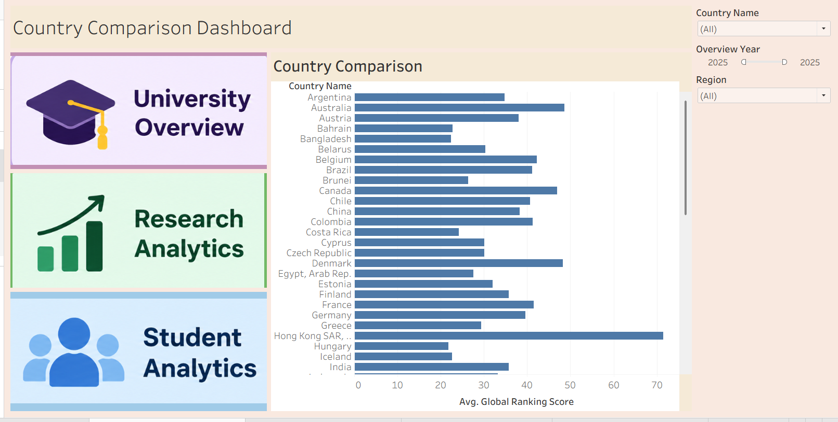
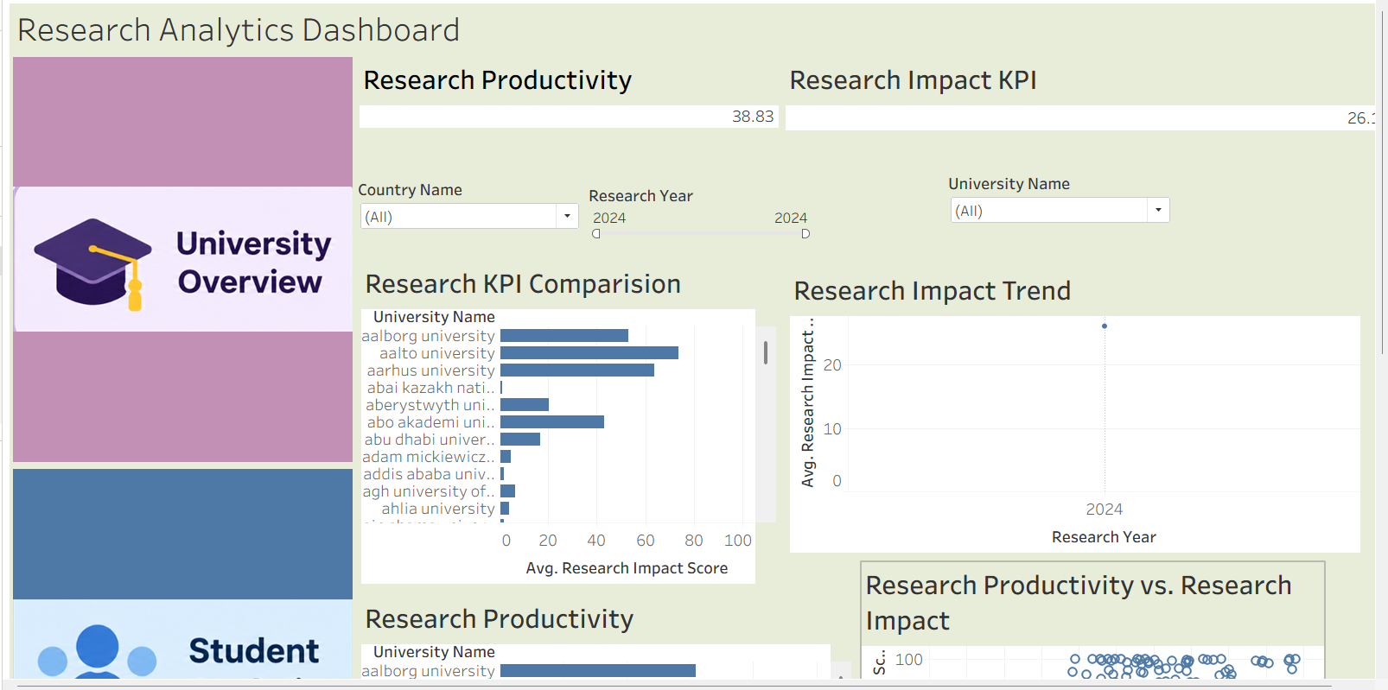
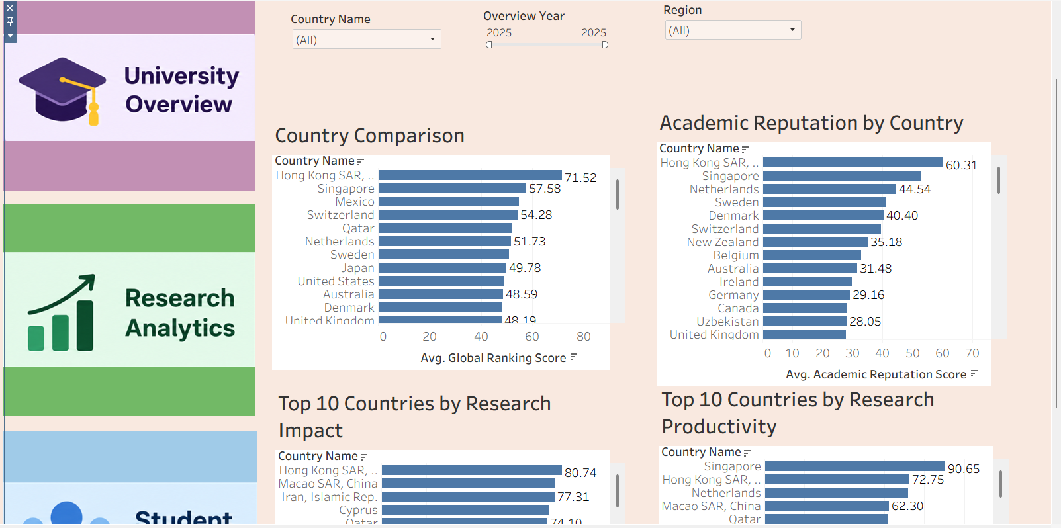
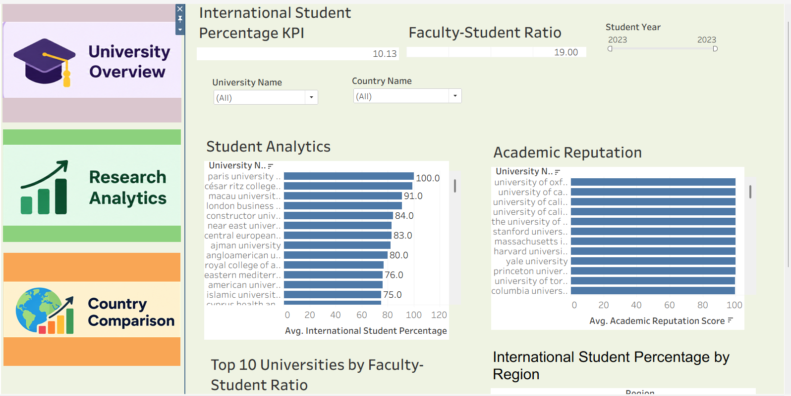
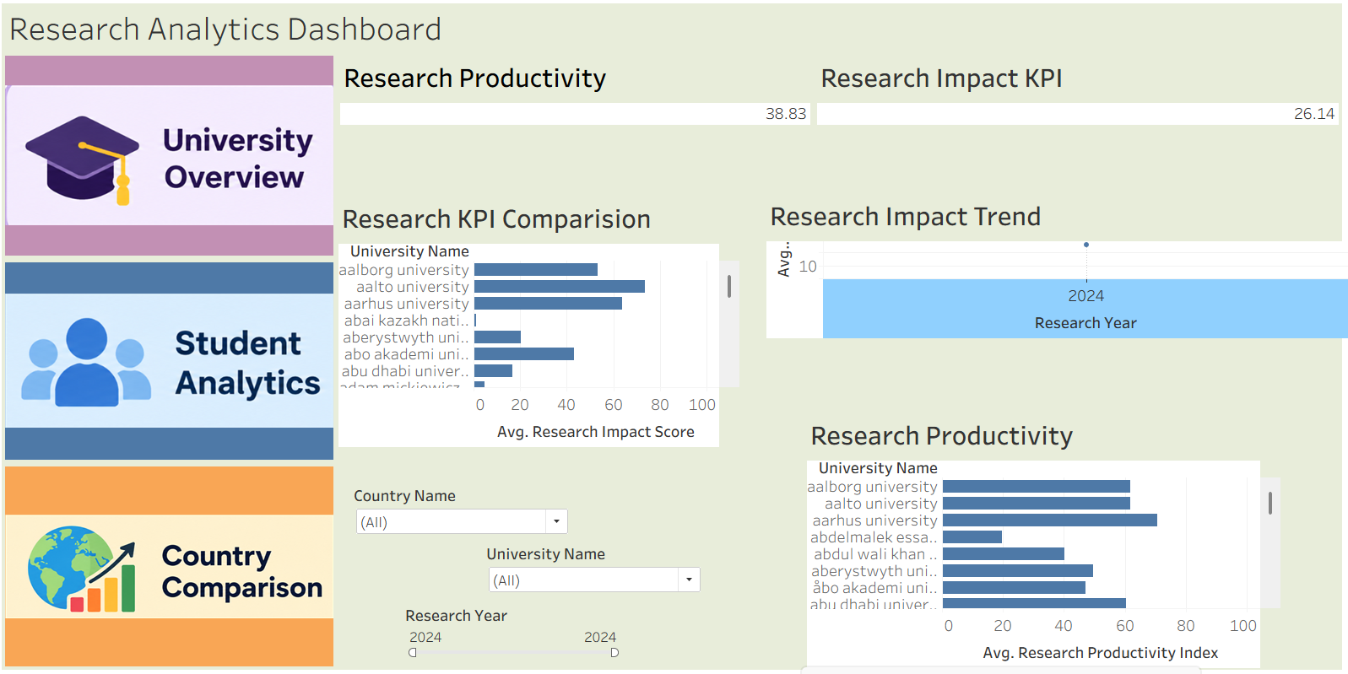
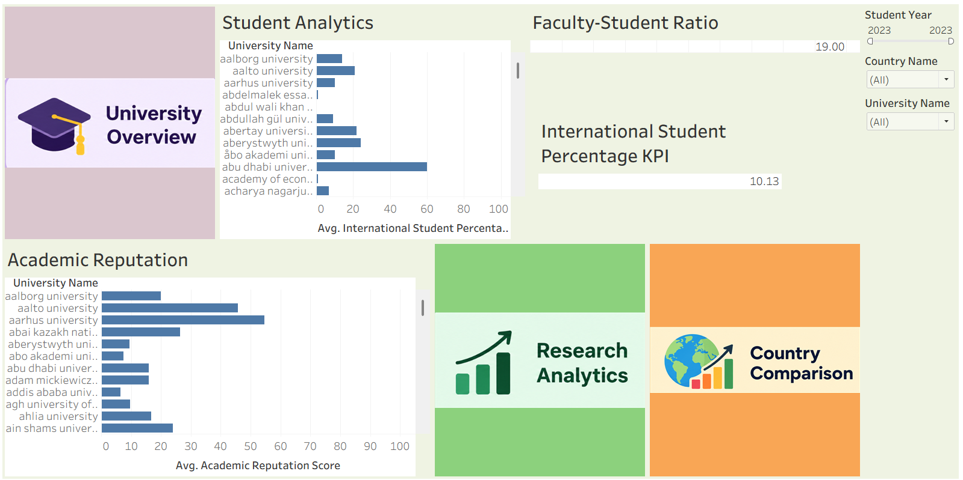
1. University Overview
2. Country Comparison
3. Research Analytics
4. Student Analytics

Slide 9
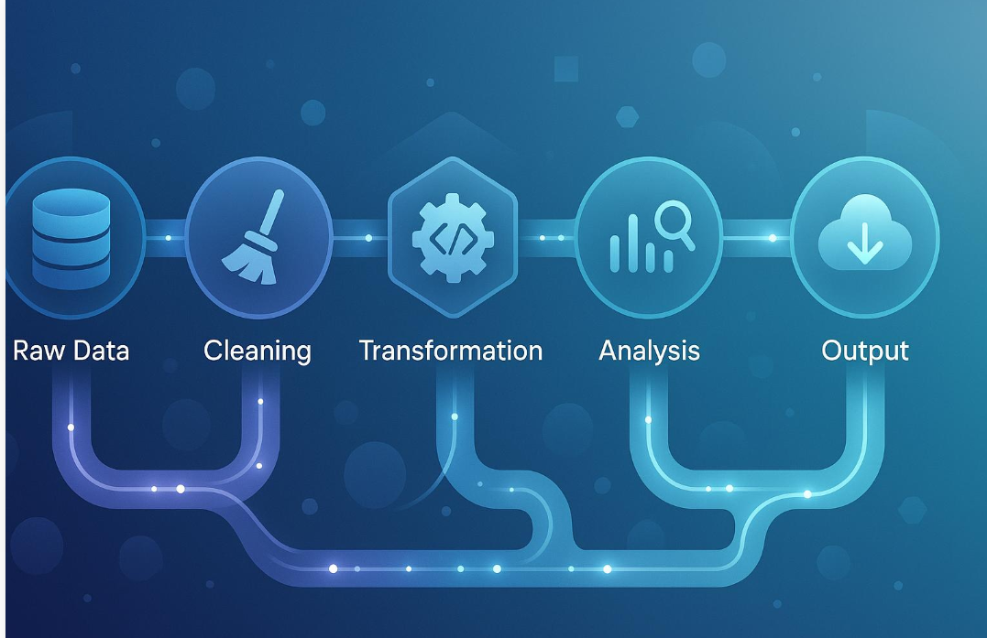

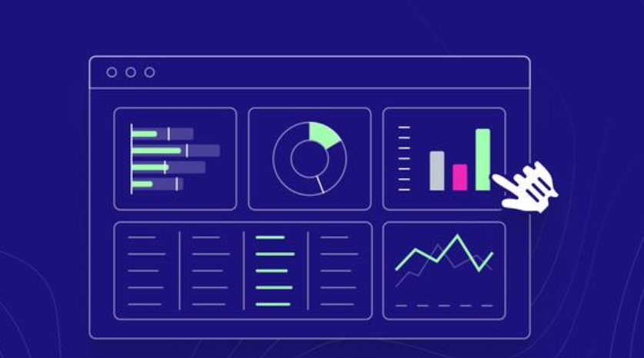
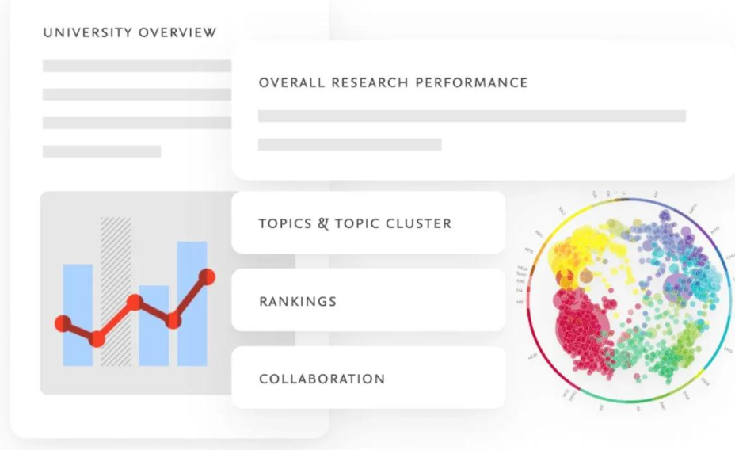
1. Data Processing and Preparation
Explain how Python, Pandas, and NumPy help inspect, clean, normalize, and validate higher education datasets before visualization.
2. University Performance Analysis
Explain how global ranking, academic reputation, research impact, and other KPIs help users examine university performance.
3. Interactive Filtering and Comparison
Describe how university, country, region, and year filters help users focus on specific information and compare results.
4. Research and Student Insights
Explain how the research and student indicators reveal different aspects of higher education performance.

Slide 10

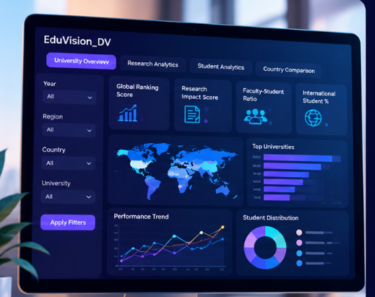

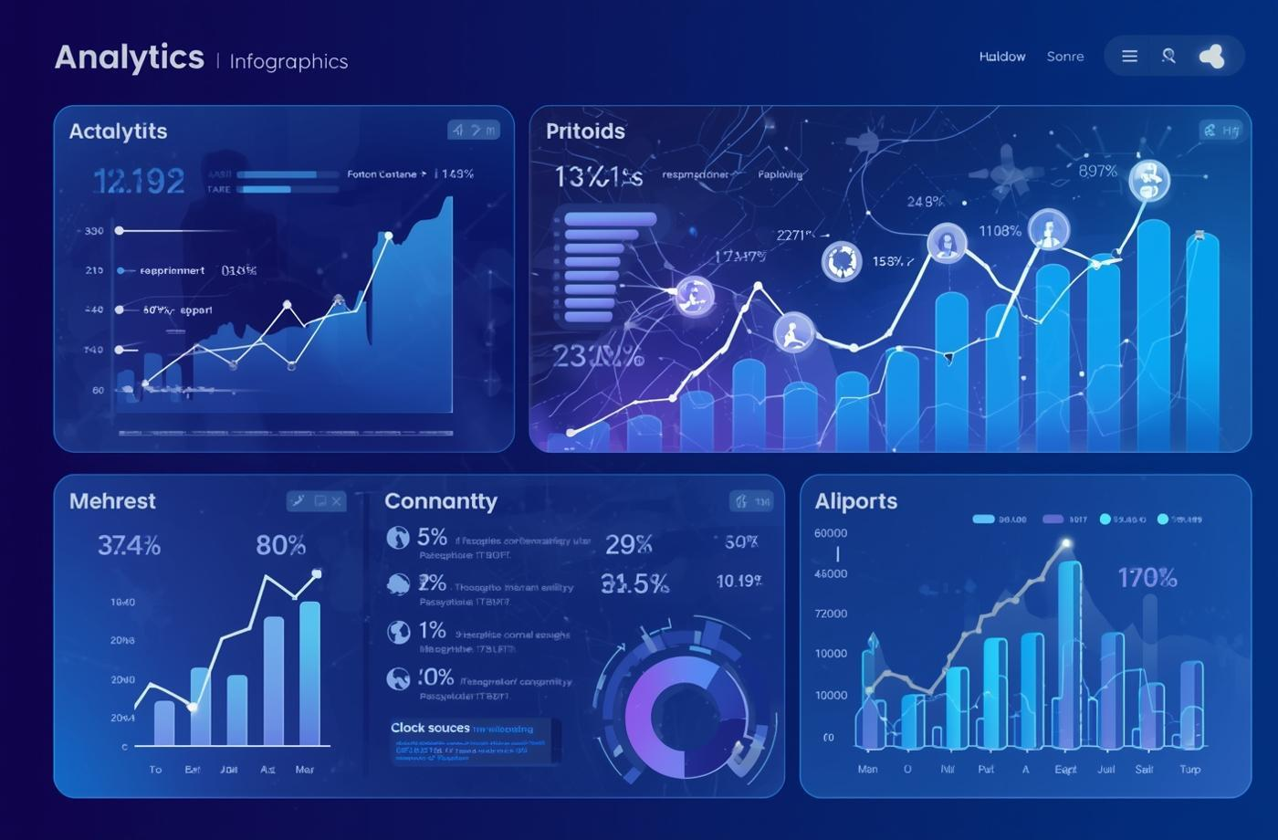


Future Enhancements for EduVision_DV
1. Advanced Predictive Analytics
Expanded Education Data Integration
Interactive and Customizable Dashboards
  Apply machine learning to identify trends in university performance.
  Forecast future research and ranking patterns using historical data.
  Support data-driven academic planning and decision-making.
  Integrate updated university rankings and education statistics.
  Include additional indicators related to teaching, research, and students.
  Improve comparisons with more comprehensive and current datasets.
  Add more flexible filters and customized university comparisons.
  Enable users to explore trends across countries, regions, and years.
  Improve dashboard accessibility and support future data updates.

Slide 11
Project By
Nuthalapati Kavya Sree
EduVision_DV

Slide 12
Q n A

Slide 13

Thank You

